Slide 1


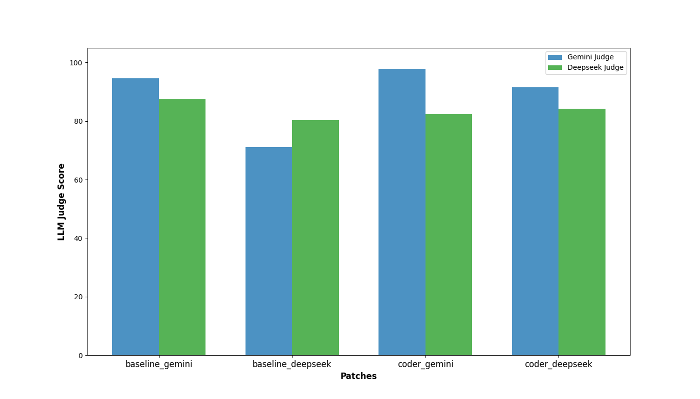
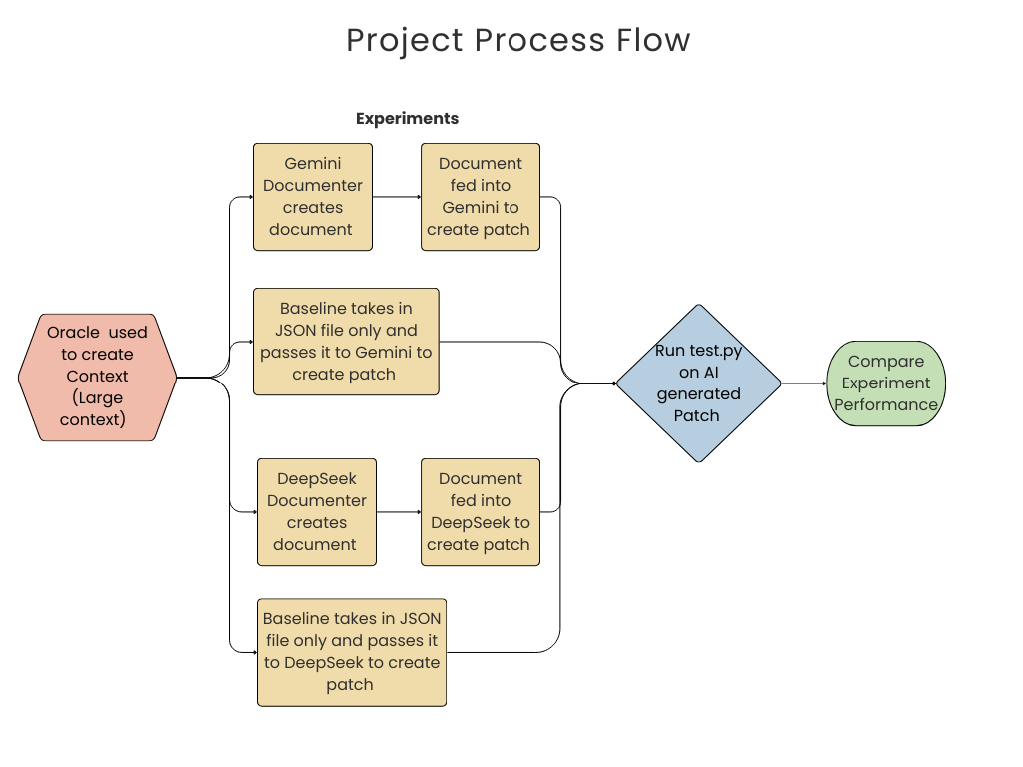
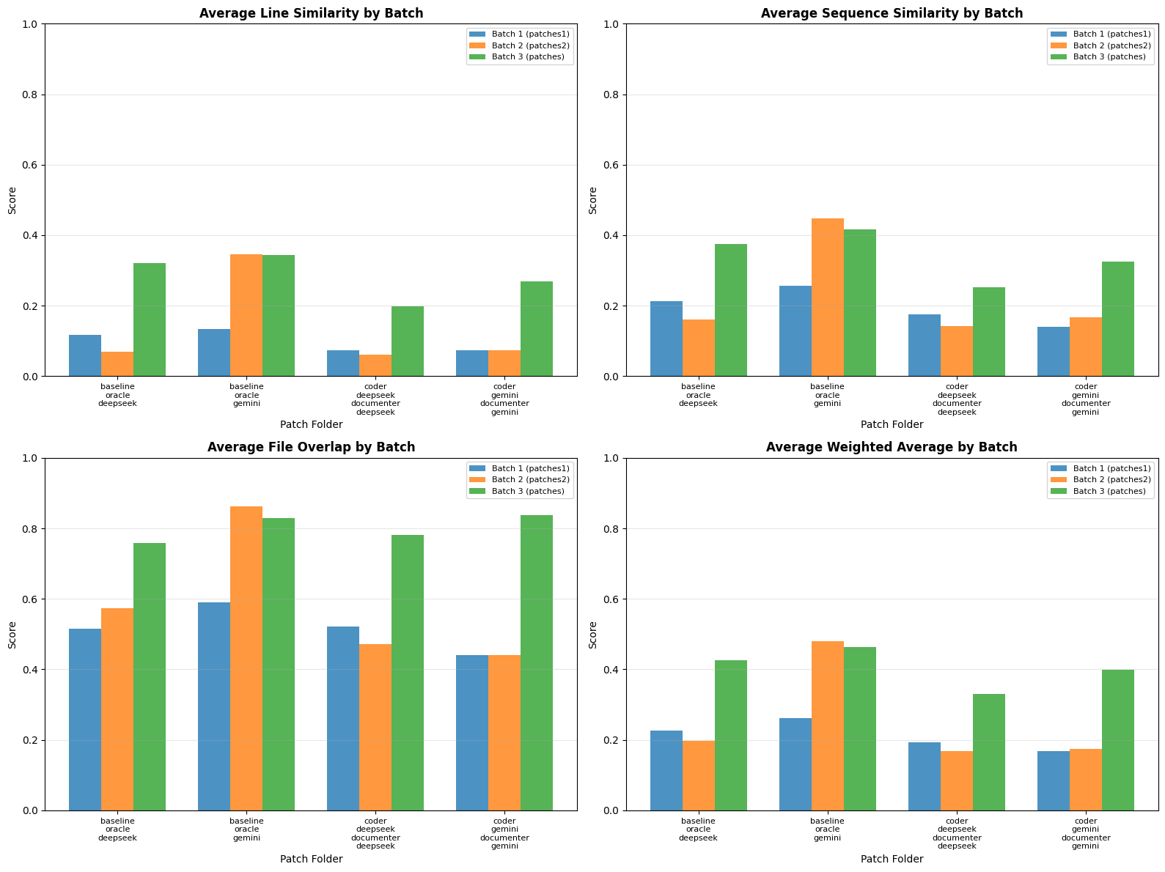
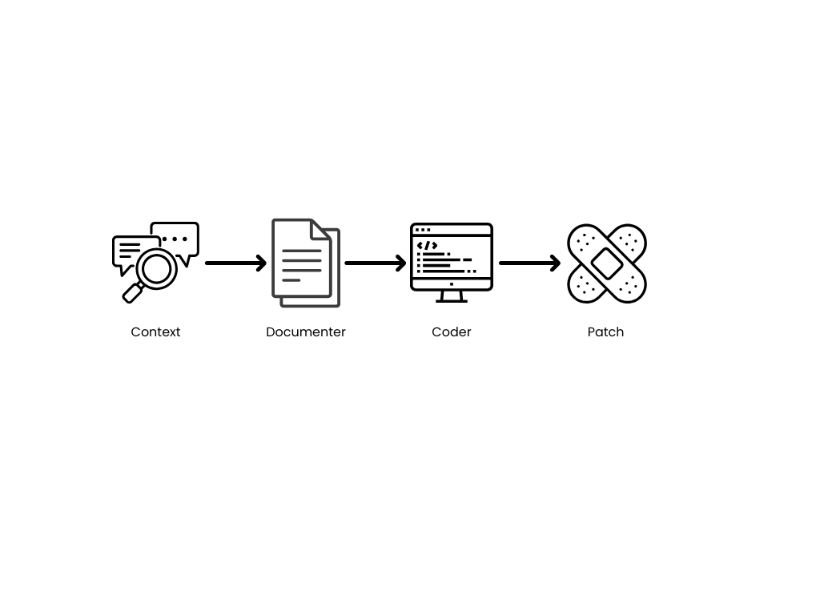
8803 Conversational AI, Georgia Tech
DocuRepoBench: Evaluating Documentation-Driven Repository-Level Code Generation
Stephanie Cho, Sarah Friedrichs,
Elaheh Rasoulian, Julie Young
Background
Experiments
Similarity Analysis Result:
  Baseline models perform best overall when combining structure, file correctness, and line similarity.
LLMs continue to scale, but large context windows are expensive and do not guarantee better performance.
Repository-level coder generation is difficult because tasks span multiple interdependent files.
Benchmarks (SWE-Bench, FEA-Bench) show LLMs perform poorly with long, unstructured repository context; more context often reduces accuracy.
Long context studies (e.g., LongCodeBench) find that even million-token windows lead to performance degradation
48 total code repositories (focusing on 20 repos and 20 tasks total)
Model | Context | Input Used for Reasoning | Patch generation
Baseline | Short | Json data | DeepSeek prompt
 |  |  | Gemini prompt
Documenter -> Coder | Large | DeepSeek Documentation | DeepSeek Coder
 |  | Gemini Documentation | Gemini Coder
2) LLM Judge: Gemini rating of the quality of the generated prompt
Prompt
You will be given a feature description and a git diff patch. You job is to score this patch on a scale of 1-100. Please consider code quality and the patch's ability to implement the feature in your score. Make sure to output the score alone without any reasoning.
Problem
Prompting Experiments: Role Based prompting (SWE vs Documenter), Hidden COT, One shot prompting
Scalable Code-Generation LLMs for Repository-Level Understanding
→Unlike prior single-model approaches, we use a two-stage documentation–coder pipeline
Example Prompt for Documenter
You are an expert software engineer tasked with creating documents that other software engineers can use to implement new features. Given a problem description and repository context, generate a detailed, specific document explaining how to implement the requested feature. Think about what features would be useful for you to have if you were going to code the feature. Your document should: 1. Be as specific possible without any ambiguity. Another software engineer should be able to clearly follow the steps outlined in your document to implement the feature 2. Synthesize a large amount of context while retaining as much valuable information as possible 3. Make clear to another engineer how to follow the coding style of the existing codebase 4. You may provide a repository overview, a clear implementation plan, pseudo-code in relevant files, or any other information that you believe would be helpful 5. Your call to action to the other software engineer should be to generate a git diff patch that implements the requested feature. 6. DO NOT ask for any other information (like adding unit tests)
Methods
Context Data
Data come from public GitHub repositories via FEA-Bench, with Oracle context adding nearby files, dependencies, configs, and documentation snippets
Baseline
Raw JSON document context is given to the model to create a patch.
Documenter-Coder Pipeline
Two step approach:
Documenter: Converts the context into a structured, human like document.
Coder: Uses that document to generate the final patch. Designed to improve path quality by enriching the model’s intermediate reasoning.
Analysis
1) Similarity Score: Overall similarity between the model-generated patch and the golden patch, capturing how closely it aligns with the intended fix.
  * Weighted Average: Combined metric (50% line + 30% sequence + 20% file overlap)
LLM Judge Analysis:
  Documenter/coder pipeline was consistently evaluated higher by the Gemini judge and sometimes evaluated higher by Deepseek
  Gemini preferred own generations, while Deepseek did not show strong preference
  Result: LLM judges may contradict other evaluation metrics
Conclusions
Two-stage abstraction is not automatically beneficial
Needs extremely reliable intermediate representations, magnify hallucinations
High-fidelity, task-local signals matter more than human-readable summaries.
For precise code edits, natural language descriptions hurt execution accuracy.
Long context ≠ better context (overload + distraction)
May introduce false instructions that distract from the required change.
Repository-level code repair remains an unsolved challenge
LLM models struggle to reason across multiple files, dependencies, and long- range interactions.
References
Wei Li et al. (2025). “FEA-bench: A benchmark for evaluating repository-level code generation for feature implementation.” In: Proceedings of the 63rd Annual Meeting of the Association for Computational Linguistics.pages 17160–17176
Notes:
- Problem: what are you trying to solve? Reference current challenges and why your work is meaningful.
- Background: problem setup + notation; maybe previous work
- Methods: explain your technical contributions; figures can really help understanding especially for a neural model!
- Experiments: what is the task? What are the inputs and outputs to the model? What are the results? Compare against baselines; for results, a graph can say a lot more than a table of the same size!
- Analysis: provide some in-depth analysis of certain cases of interest, or contextualize your results within existing literature! Add some plots/examples/visualizations.
- Conclusions: briefly draw some conclusions from the work
- References: if space permits, consider adding 1-3 very important references (donʼt do more than this!)

